Slide 2
Seeding Innovations in Prevention from a Human-centered Design Lab for Domestic Violence Prevention, 2018-2021
June 2021

Slide 3
Overview
The Reimagine Lab Vision
Reimagine Lab Origin Story
Growing Capacity for Innovations
Outcomes

Slide 4
The Challenge | Domestic violence by the numbers
58% of Californians
Three women per day
20 people per minute
have experienced domestic violence
are murdered by someone they dated or married
are abused by intimate partners in the U.S.
https://blueshieldcafoundation.org/publications/taking-action-to-end-domestic-violence
https://blueshieldcafoundation.org/publications/perryundem-californians-views-gender-sexism-and-domestic-violence

Slide 5
The Vision | Breaking cycles of violence
Focusing on prevention
Moving from portrait to landscape
Discover new equitable solutions
Identifying the multigenerational nature of violence
Beyond treatment or crisis interventions
Power and control in complex relationships and contexts
Not just a single story, but many intersecting ones with unique identities and communities
Reflecting diverse stories, including those who cause harm
Centering lived experience and addressing systemic oppression

Slide 6
Human-centered design
a collaborative problem-solving approach with creative methods for deeply understanding human behavior to develop new solutions in direct collaboration with the individuals impacted by the problem

Slide 7
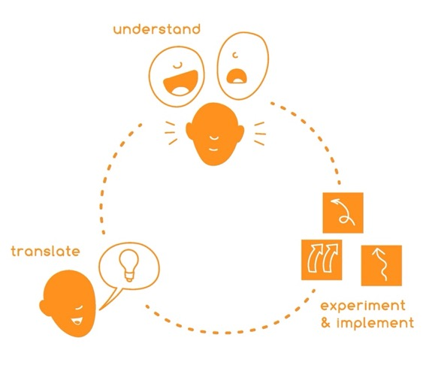
The Concept | Human-centered design lab for actionable solutions
Understand context and users
Examine drivers of systems change
Collaborate with and center those with lived experience from historically oppressed communities
Translate insights to possible solutions
Experiment solutions for implementation
Community-level prevention at the intersection of health and domestic violence
© Gobee Group 2021, used with permission
“This process is meant to be disruptive. It creates space for creative tension. If you remain comfortable, you are not doing it right.”
~ Olivia Nava, Sr. Design Strategist at Gobee Group

Slide 8
16 fellows selected from hundreds of applicants

Slide 9
Honoring diversity, centering equity, and using an
anti-oppression approach
A wide range of diversity in both lived and professional experience in the cohort created space for new ideas, pushback, vulnerability, and radical honesty, as well as a need for getting on the same page

Slide 10
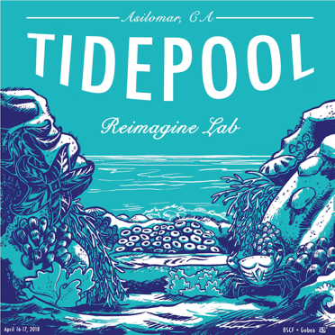
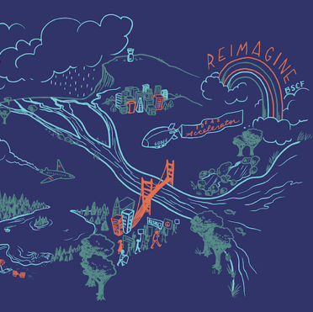
Year 1 | Six-month design lab
TIDEPOOL
Asilomar
Community Building
PANORAMA
Long Beach
Strategic Foresight (Futures)
DELTA
Sacramento
User Groups
16 fellows developed 10 concepts
IDEAS ACCELERATOR
Berkeley
Expert Feedback
PINECONE
Incline Village
Prototyping
PUERTO
San Diego
Launching Ideas
Top 3 concepts chosen and all fellows invited back for Y2

Slide 11
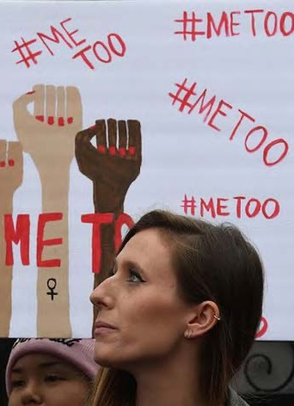
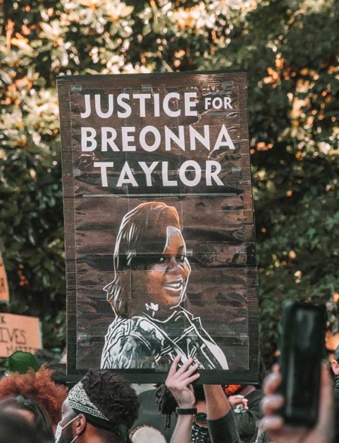
The Context | Creating resilience amidst turmoil
Photo credits from left :
Donna Rotunno, Attribution, via Wikimedia Commons
Natalie Chaney on Unsplash
Maria Oswalt on Unsplash

Slide 12
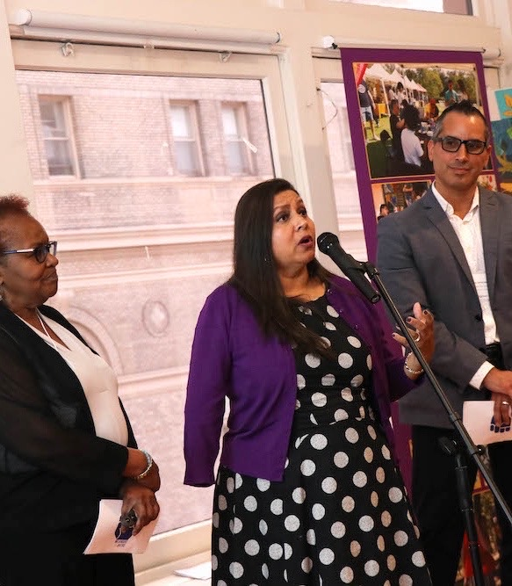
Year 2 | Prototyping & iteration
12 fellows continued to pursue ideas generated from Year 1. Together they:
Set learning objectives for prototyping
Executed rounds of testing how the ideas exist in real space
Collected feedback from users
Iterated on what was learned to develop project focus
Pitched ideas on Demo Day
Emphasis on storytelling, team building and working with user groups to collaboratively create concepts

Slide 13
Prototypes are testable samples of a concept
“I will always treasure your gifting and introduction to the Human Centered Design process, particularly around iteration and prototyping. I feel it is a great antidote for perfectionism.”
~ Sharon Turner, Reimagine Lab Fellow

Slide 14
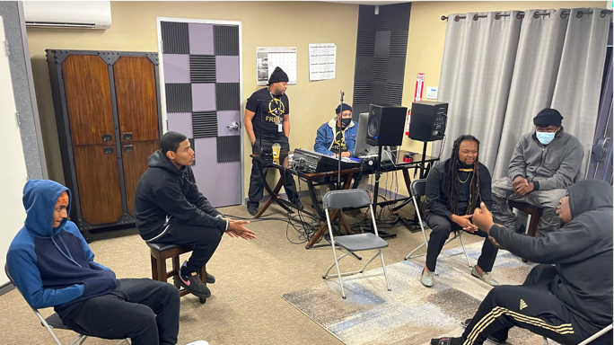
Year 3 | Incubate & implement
6 fellows continued on to…
Test the concept with users
Develop the project in teams
Build necessary partnerships and staffing
High levels of engagement with each venture in the face of global pandemic
Created a fully virtual 8-month projects in incubator-to-implementation format
Gobee Group provided tailored technical assistance and coaching

Slide 15
Catalyzing domestic violence prevention innovation

Slide 16
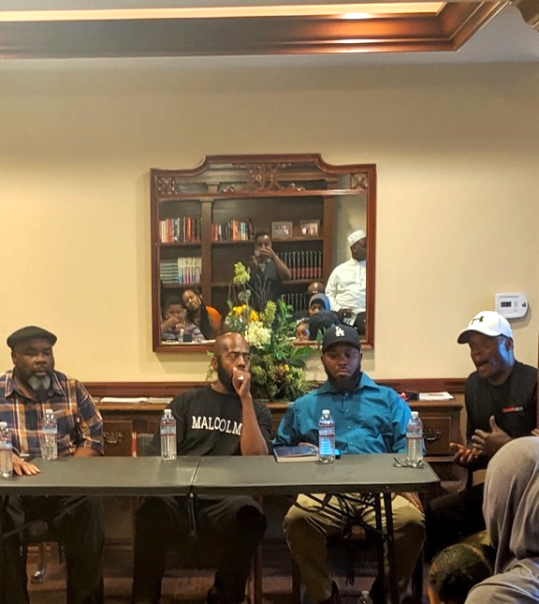
Anti-Violence Ventures: Black Men & Boys Take the Lead
Mission
Anti-Violence Ventures (AVV) intends to break the cycle of violence in the Black community through a series of conversations that engage Black men and boys.
Focuses on the intrinsic links between domestic, family and community violence in Black neighborhoods
Raises awareness about different forms of violence through storytelling, reflection, and education
Supports Black men and boys in engaging in transformative dialogue and action around violence and violence prevention
Holds spaces free of judgement to enable men to share their experiences
Team
Sonya Young Aadam
http://antiviolenceventures.org/
Learn More

Slide 17
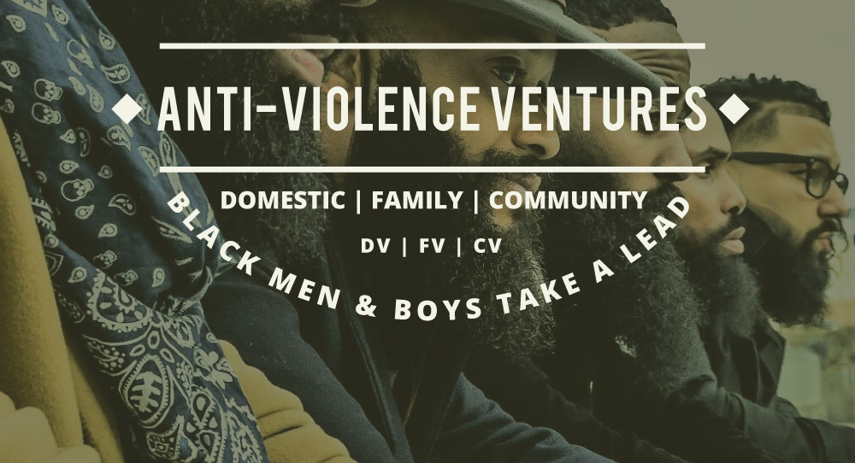
Anti-Violence Ventures: Black Men & Boys Take the Lead
A Prevention Approach
Intersections • Inclusion
Incentives • Intention

Slide 18
Anti-Violence Ventures: Black Men & Boys Take the Lead
“Two roads diverged in a wood, and (we) took the one less traveled by..." - robert frost

Slide 19
Anti-Violence Ventures: Black Men & Boys Take the Lead

Slide 20
Anti-Violence Ventures: Black Men & Boys Take the Lead

Slide 21
Anti-Violence Ventures: Black Men & Boys Take the Lead

Slide 22
Anti-Violence Ventures: Black Men & Boys Take the Lead

Slide 23
Anti-Violence Ventures: Black Men & Boys Take the Lead

Slide 24
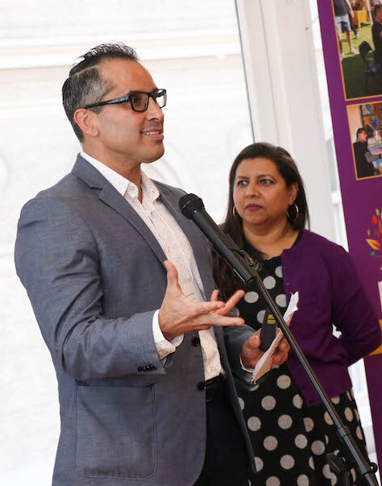
Influencers4Justice
Vision
With deep connections to their own communities, there is a tremendous opportunity to engage community leaders to be part of domestic violence prevention. By engaging Community Influencers from non-traditional sectors, the work of prevention can belong to everyone.
Collaborates with artists, faith leaders, activists, organizers to influence social and behavioral norm change within their own communities
Provides opportunities for partners to work with advocates to develop the appropriate domestic violence prevention strategy for their organizations, networks, and communities
Shifts from the belief that domestic violence prevention is the exclusive responsibility of experts
Team
Jorge Fernandez, Sandra Henriquez, Sharon Turner
Learn More

Slide 25
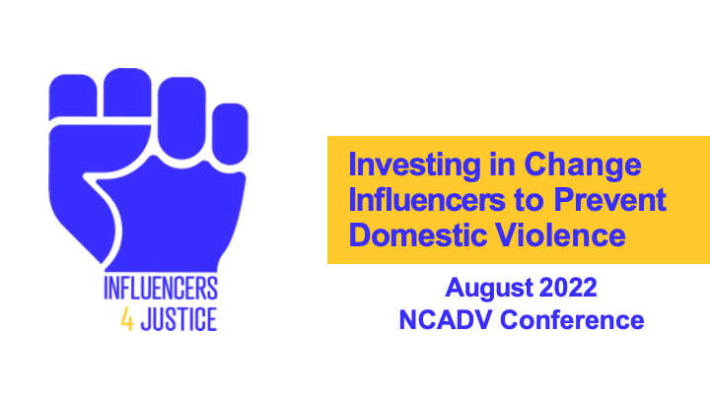
Influencers4Justice

Slide 26
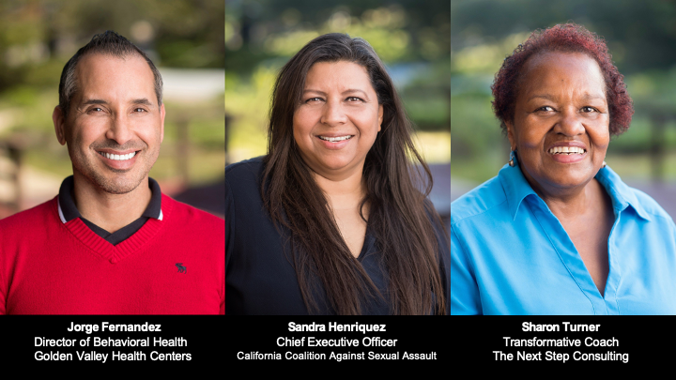
Influencers4Justice

Slide 27
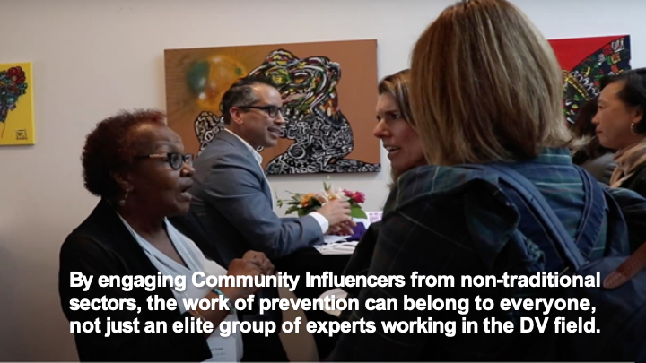
Influencers4Justice

Slide 28
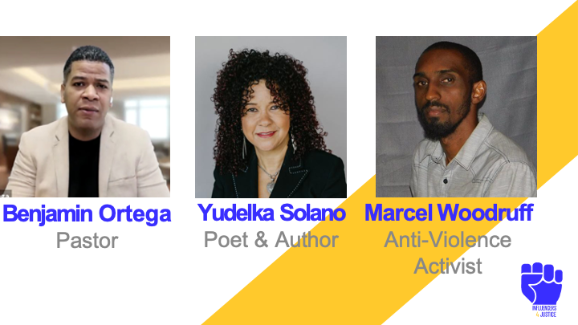
Influencers4Justice

Slide 29
Influencers4Justice

Slide 30
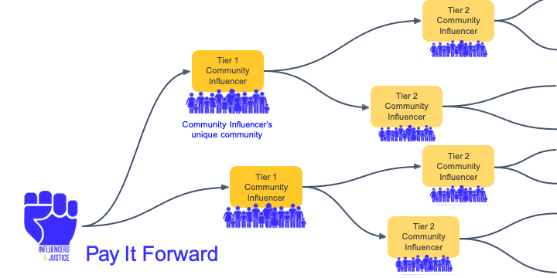
Influencers4Justice

Slide 31
STEEP Human-Centered Design Tool
STEEP
Human-Centered
Design Tool

Slide 32
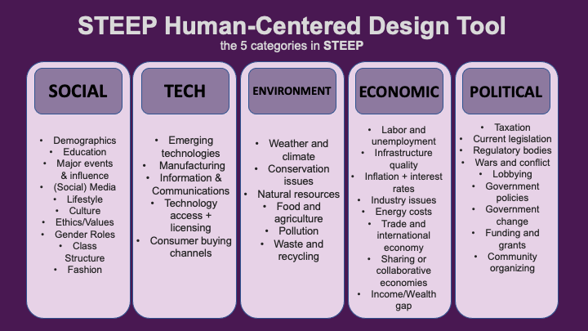
STEEP Human-Centered Design Tool

Slide 33
STEEP Human-Centered Design Tool
STEEP Human-Centered Design Tool the 5 categories in STEEP
SOCIAL
TECH
ENVIRONMENT
ECONOMIC
POLITICAL

Slide 34
The time has come for us to reimagine everything
“The permission and time to ‘reimagine’ and be creative was essential in pushing me to think outside of the box. We get caught in traps of doing things the way we’ve always done them. Reimagine Lab set the expectation that we are doing something new.”
~ Reimagine Lab Fellow

Slide 35
Thank you!
Questions?
Find more information about
blueshieldcafoundation.org

